Slide 1
Group 5
Team Member: Kyeongho Min, Harshita Gupta, Sanjoli Sirohi, Zhirou Zhang, Jiamin Zhu
ML Project
--- Fake and Real News Detection

Slide 2
1
Project Introduction
2
Project Objective
3
Dataset Characteristics
4
Data Preparation and Cleaning
AGENDA
5
Data Processing and training
6
Testing and Evaluation
7
Ethic Issues
8
Conclusion

Slide 3


01
Project Introduction
PART ONE

Slide 4


Project introduction
News is one of the major source to adopt information
Fake news is false or misleading information presented as news.
Distinguish fake news and real news is an important and urgent task

Slide 5
02
Project Objective
PART SECOND

Slide 6
Project Objectives
Define fake news
01
Use fake/real news train data to generate the pattern of both types news
Compare fake/real news
Compare attributes of fake and real news
02
Predict news
03
Establish a model that can predict the probability of the news is fake or real

Slide 7
03
Dataset Characteristics
PART THREE

Slide 8

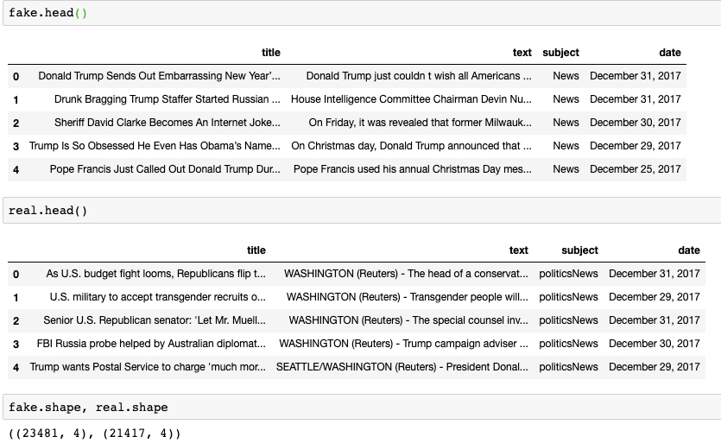
Dataset Characteristics
Fake dataset
23,481 rows | 4 columns
Real dataset
21,417 rows | 4 columns

Slide 9
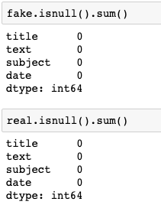
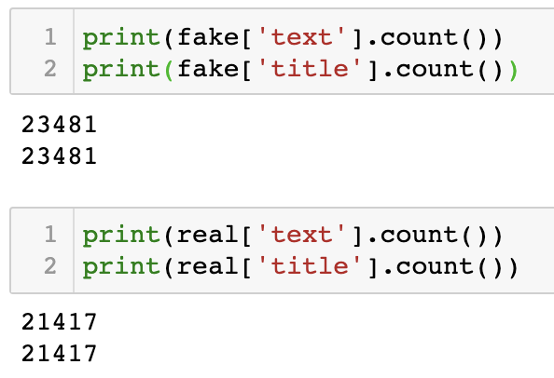
Dataset Characteristics
No missing value for both datasets
No duplicate data for both datasets

Slide 10
04
Data Preparation and Cleaning
PART FOUR

Slide 11
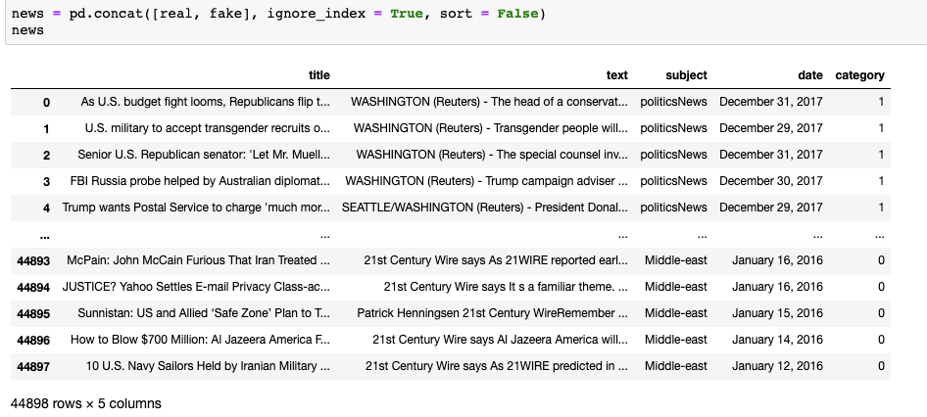
Combine two datasets and create a new column called ‘category’ to indicate if this is the fake news

Slide 12
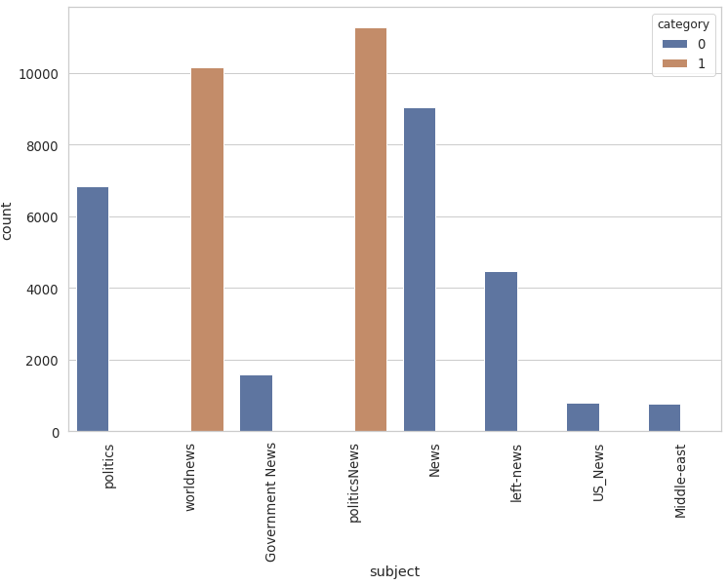
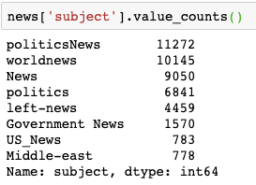
Data analysis for subject column
Notes:
Real news has only politicsNes and worldnews subject, blahblahb
→ We need to remove subject column

Slide 13
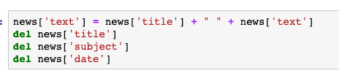
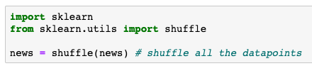
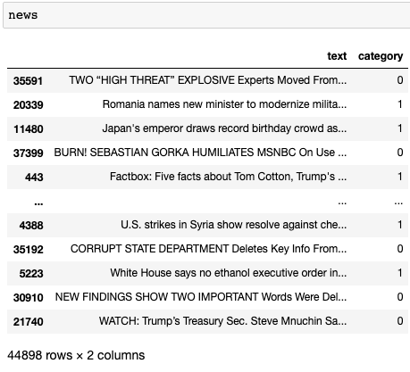
Delete ‘subject’ and ‘date’ column and combine ‘title’ and ‘text’ column and shuffle all data points

Slide 14
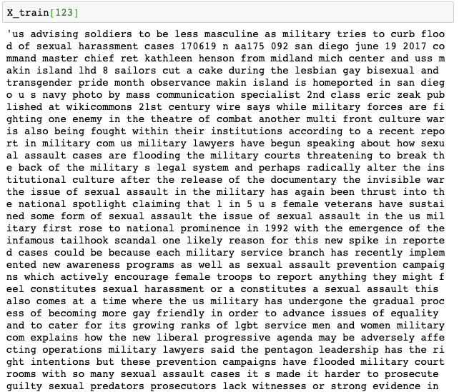
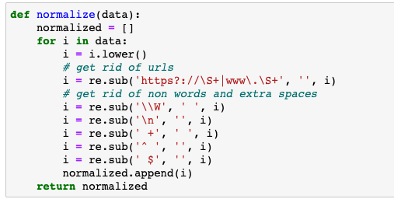
Remove urls and non words, extra spaces and punctuation

Slide 15
05
Data Processing and training
PART FIVE

Slide 16





NLP
Natural language processors(NLP) work by converting words (text) into vectors.
These vectors are used to train an AI/ML models to make predictions.
NLP is used for many applications including:
Investigate discovery
Subject-matter expertise
Social media analytics
AI/ML-based fake news detector is crucial for companies and media to automatically predict whether circulating news is fake or not.
In this case study, we will analyze thousand of news text to detect if it is fake news.
Fake News Detector (NLP Model)

Slide 17
Tokenizer
Tokenizer allows us to vectorize text corpus by turning each text into a sequence integers.
Sentence:
“Budget fight looms republicans flip…”
Tokens:
[3138, 3581, 3895, 27, 5354…”

Slide 18
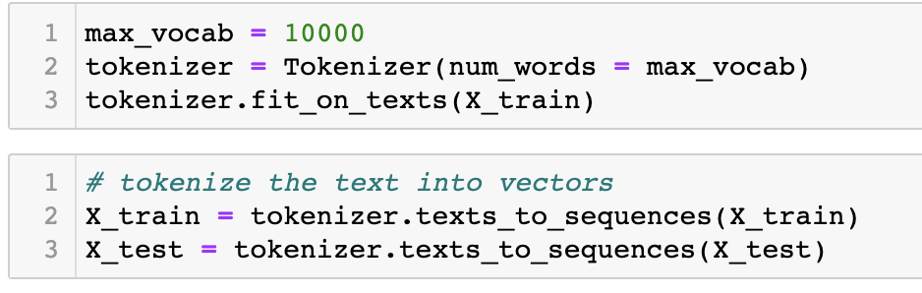
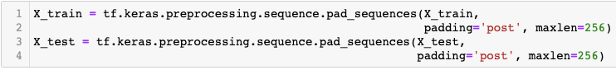
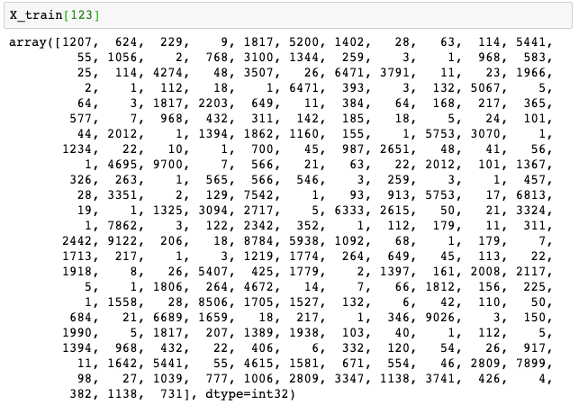
Tokenize training data into vectors and padding

Slide 19
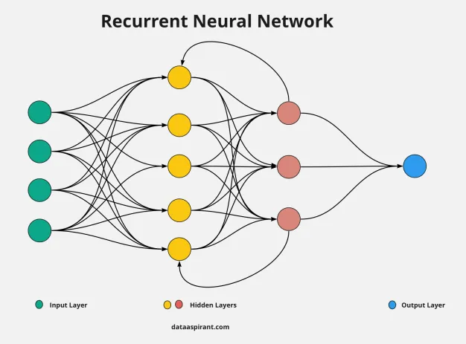
Recurrent Neural Networks(RNN)
A RNN is a type of ANN that is designed to take temporal dimension into consideration by having a memory (internal state) (feedback loop).

Slide 20
Recurrent Neural Networks(RNN)
Normal neural networks like CNN(Convolutional Neural Networks are feed forward networks as they only consider the current input and have no memory saved of the previous predictions on the previous inputs .
General function of RNN is forward propagation over time .
RNN uses the internal memory to remember important things about input and is very precise in predictions as it not only consider
Current information but also the previous predictions.
We use RNN while handling sequential data , like Time
Series Analysis in Stock Prediction ,Sales Forecasting
etc.

Slide 21
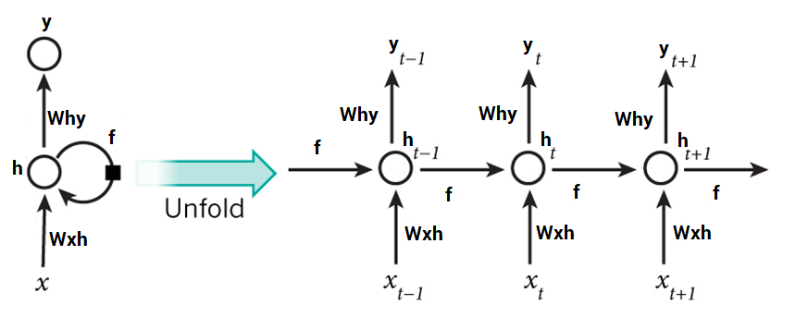
RNN Architecture
A RNN contains a temporal loop in which the hidden layer not only gives an output but it feeds itself as well.
An extra dimension is added which is time!
RNN can recall what happened in the previous time stamp so it works great with sequence of text.

Slide 22


What make RNNs so special?
RNN allow us to work with a sequence of vectors:
Sequence in inputs;
Sequence in outputs;
Sequence in both.
Output: CUTE GRAY AND WHITECAT
Input: CAT
One to One
Application: regression and classification
One to Many
Application: image captioning, input = image, output = sentence of words
Output: 1
Input: I am really enjoying this course!
Many to Many
Application: language translation
Many to One
Application: Sentiment Analysis. Eg, is a review positive or negative?

Slide 23
Embedding Layer
Embedding Layer is the first hidden layer of the network.
Embedding layers learn the low-dimensional continuous representation of input discrete variables.
For example, let assume that we have 100,000 unique values in our data and want to train the model with this data. Even though we can train the model to generate accurate results, it would require more resources to train.
Alternatively, by introducing an embedding layer, you can specify the number of low dimensional features that you would need to represent the input data, in this case let’s take the value to be 200.
Now, what happens is the embedding layer learns the way to represent 100,000 variables with 200 variable only.
This in-turn helps subsequent layers learn more effectively with less compute resources.

Slide 24
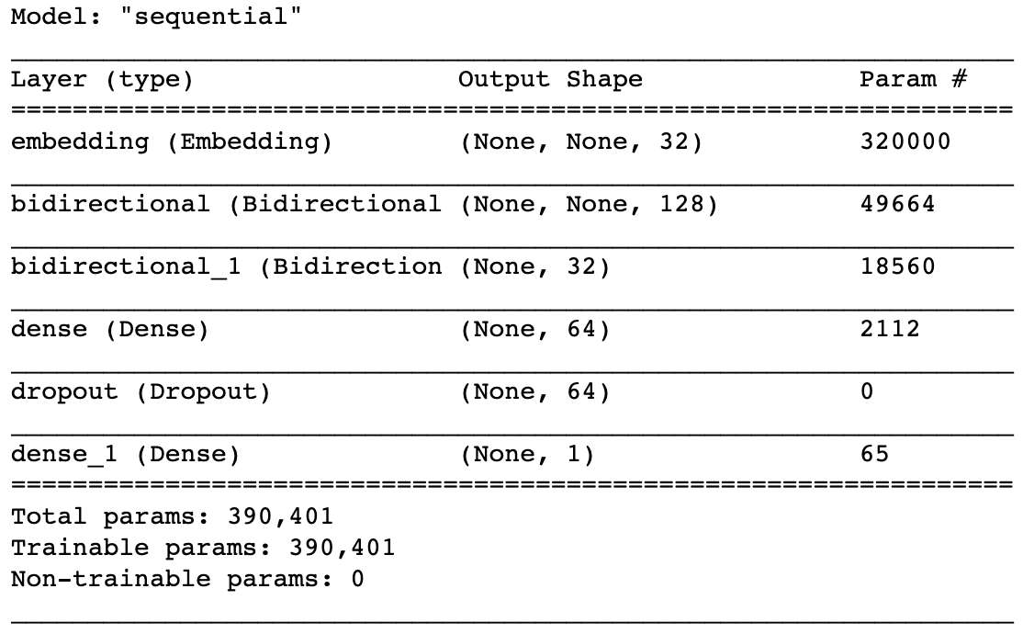
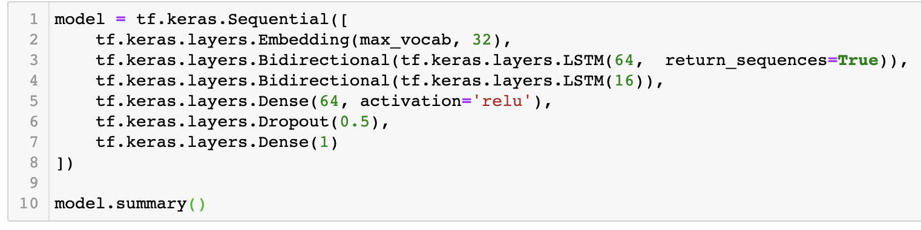
Building the RNN

Slide 25
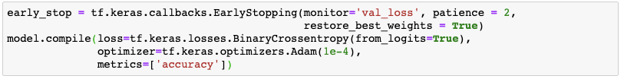
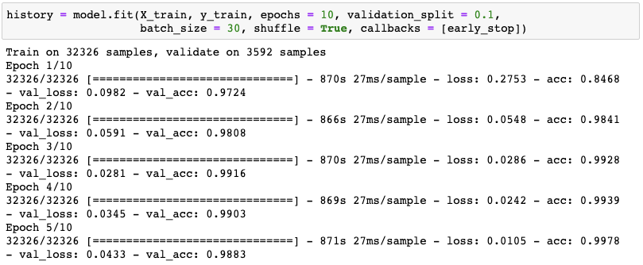
Fitting the training data using early stop

Slide 26
06
Testing and Evaluation
PART SIX

Slide 27
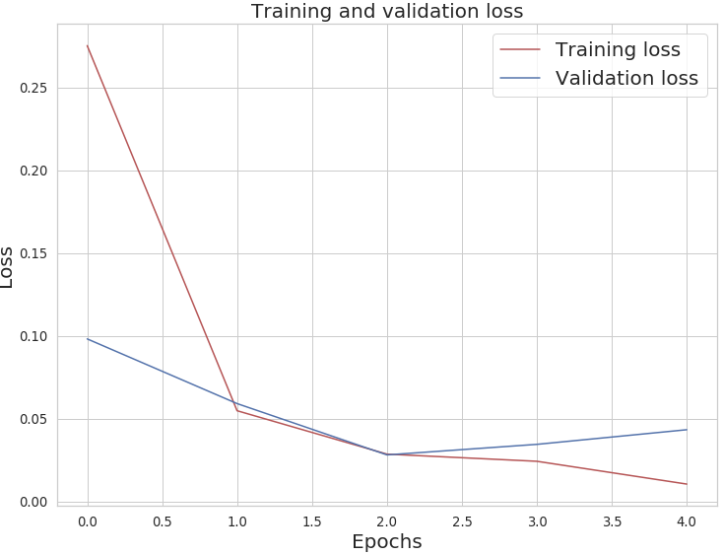
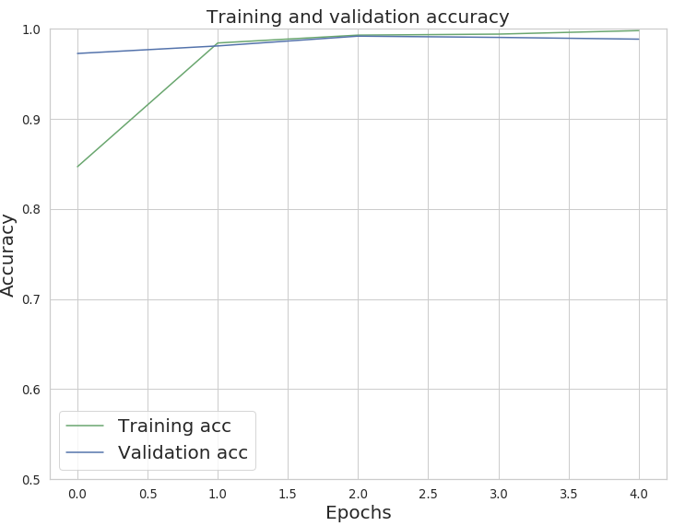
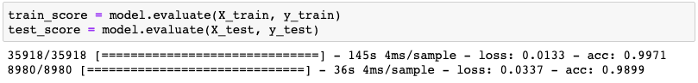
Visualize our training over time and evaluate testing set

Slide 28
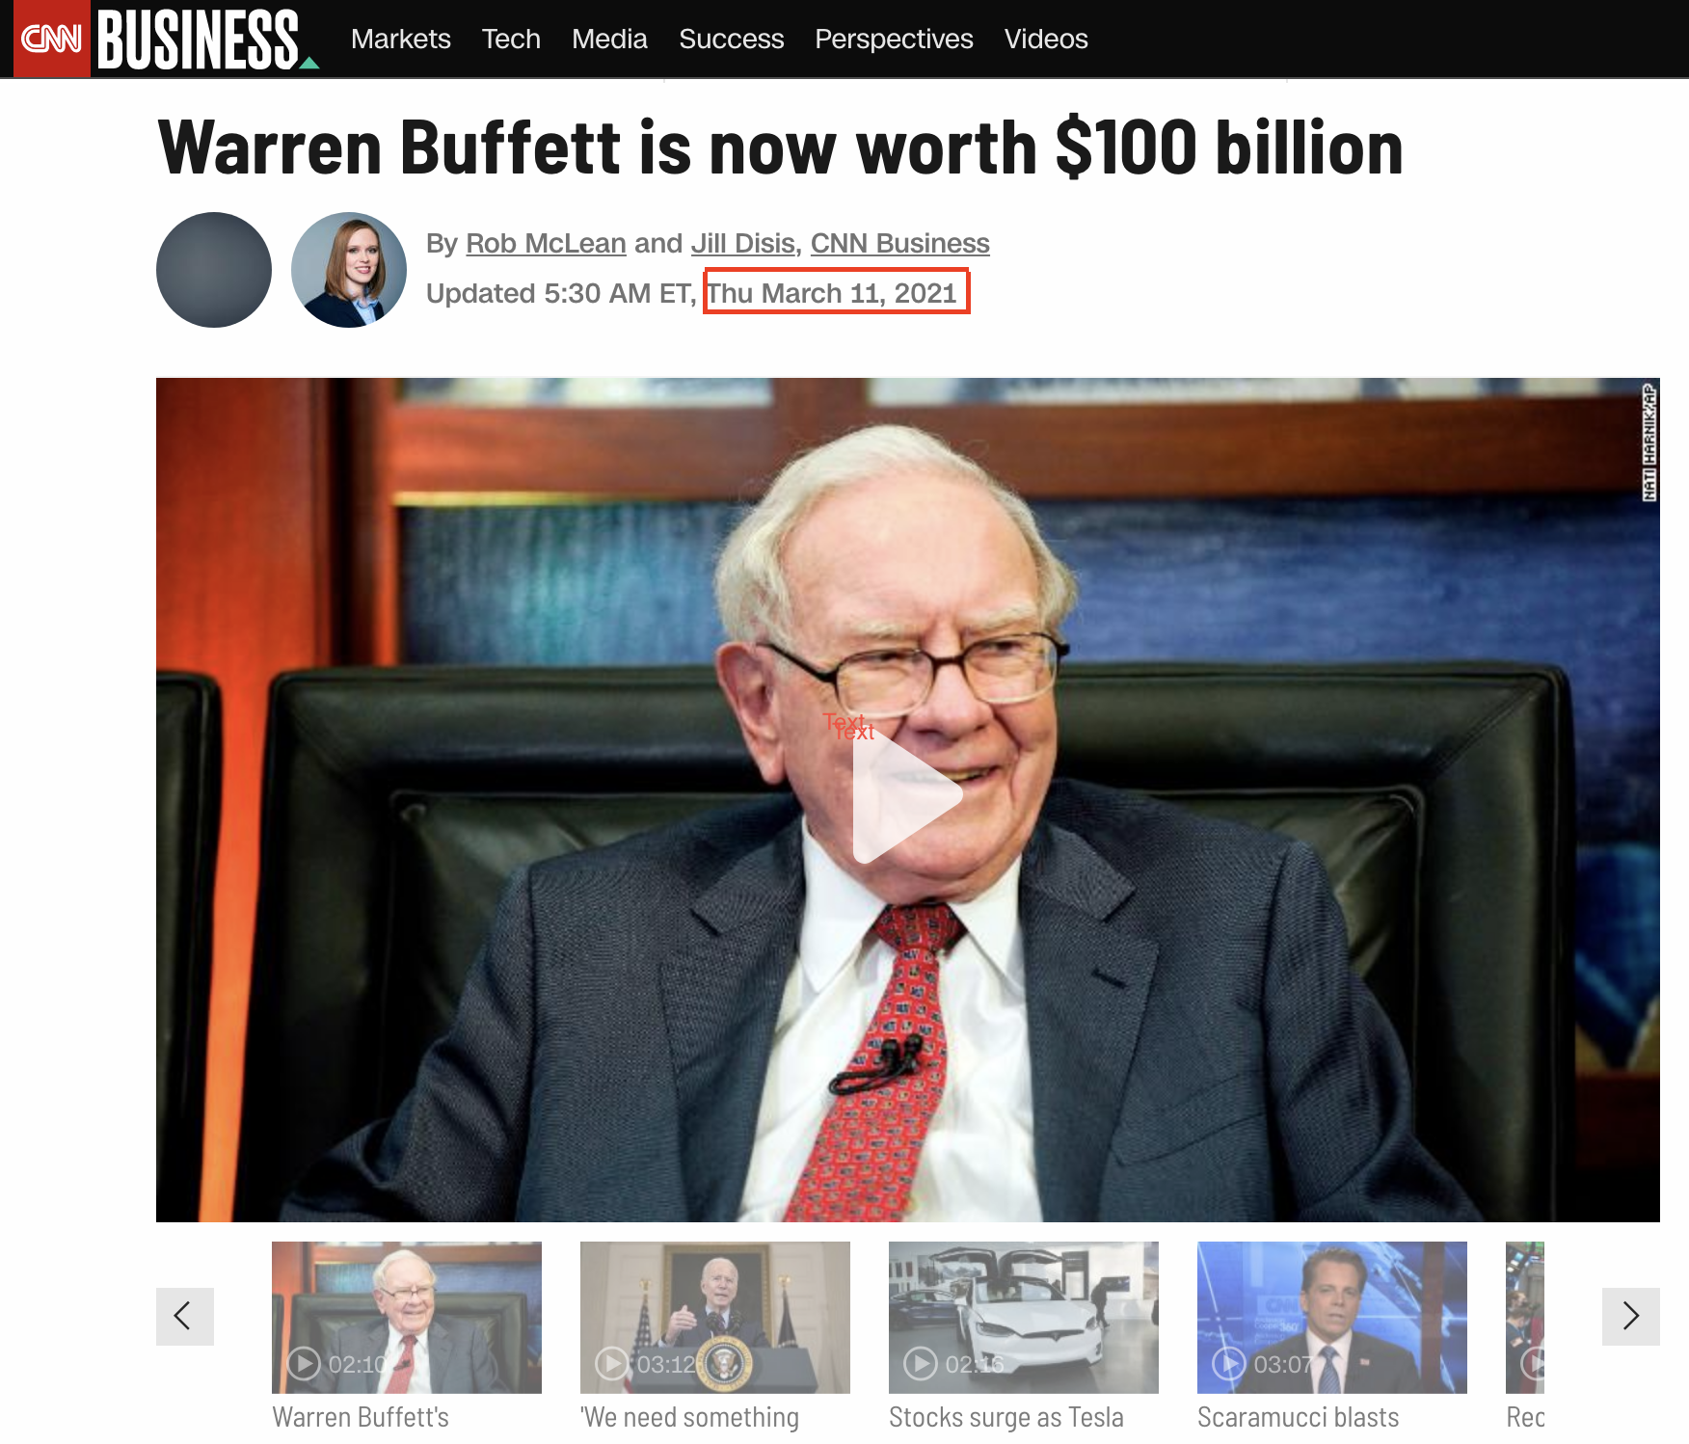
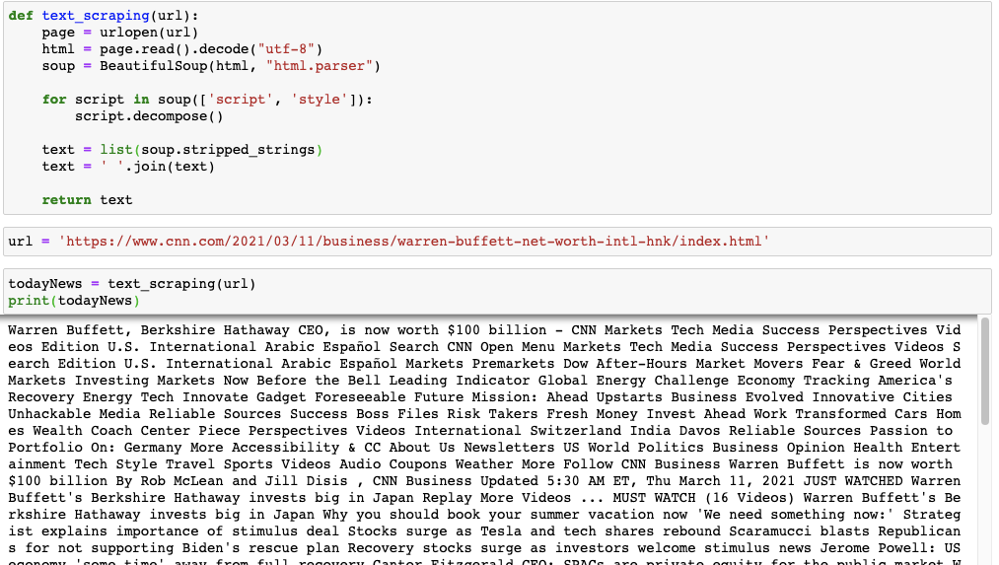
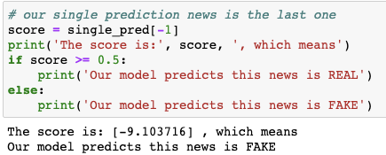
Single prediction - Today’s news
Notes:
Fake...

Slide 29
07
Ethical Issues
PART SEVEN

Slide 30



Humanity
Accuracy
Bias Evaluation
Explainability by Justification
Privacy

Slide 31
08
Conclusion
PART EIGHT

Slide 32
Fake news Identification become a critical issue to reduce the spread of fake news decreasing its negative impact to the society.
By using NLP and RNN techniques, identify the key attributes of fake and real news.
We obtained both fake and real news datasets to train our model to predict the news in high accuracy.

Slide 33
Thank you so much!

